Slide 1
A Novel Method for Protein Secondary Structure Prediction Using Dual-Layer SVM and Profiles
PROTEINS: Structure, Function, and Bioinformatics 54:738–743 (2004)
Jian Guo, Hu Chen, Zhirong Sun, and Yuanlie Lin
Presenter: Jun-Shong Lin
Date: September 14, 2006

Slide 2
Abstract
A high-performance method was developed for protein
secondary structure prediction based on the dual-layer
support vector machine(SVM) and position-specific
scoring matrices(PSSMs). SVM is a new machine
learning technology that has been successfully applied
in solving problems in the field of bioinformatics. The
SVM’s performance is usually better than that of
traditional machine learning approaches. The
performance was further improved by combining PSSM
profiles with the SVM analysis.

Slide 3
Abstract (Cont.)
The PSSMs were generated from PSI-BLAST profiles,
which contain important evolution information. The
final prediction results were generated from the second
SVM layer output. On the CB513 data set, the three
-state overall per-residue accuracy, Q₃, reached 75.2%,
while segment overlap(SOV) accuracy increased to
80.0%. On the CB396 data set, the Q₃ of our method
reached 74.0% and the SOV reached 78.1%.

Slide 4
Introduction
In 2001, Hua and Sun introduced a new method, support vector machine(SVM), which is based on statistical learning theory(SLT). The SVM method achieved good segment overlap accuracy, SOV=76.2%, and good three-state overall per-residue accuracy, Q3=73.5%.

Slide 5
Materials and Methods
Date Set:
<1>RS126
<2>CB513
(The homology measurement of CB513 is more strict than in the RS126 set.)
<3>CB396
(Removal of protein chains contained in both the RS126 set and the CB513 set)

Slide 6
The Definition of Protein Secondary Structure
This work exclusively used the DSSP assignments, which distinguish the secondary structure into 8 categories:
H (α-helix), G(310 helix), I (π-helix), E (extended β-strand), B (isolated β-strand), T (turn), S (bend), and coil (“_”).
DSSP: H, G to H; E, B to E; all other states to C;

Slide 7
PSI-BLAST Profiles
CB513
CB396
Multiple Alignment
………
………
Database
……
……
Profiles

Slide 8
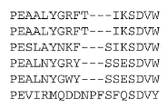
PSI-BLAST Profiles
Multiple Alignment.
Collect frequencies of each amino-acid.
1 2 3 4 5 ……………….....19
A
C
D
E
0 0 …….
0 0 ….....
0 6
Compute log odds score for observing
Given amino-acid at given position.
….
P
6 0
…..…....
…………………………

Slide 9

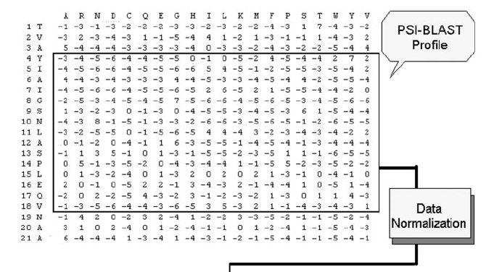
Coding Scheme

Slide 10
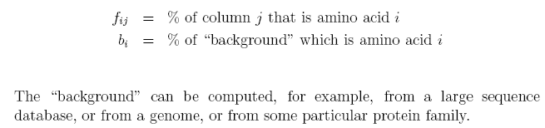




PSI-BLAST Profiles
Position
Example:
1 2 3 4
1.
2.
3.
4.
L E V K
L D I R
L
V
D
L E I K
L D V E
………
Amino acid

Slide 11
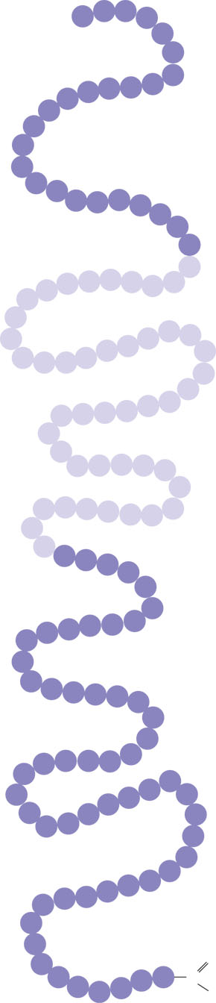
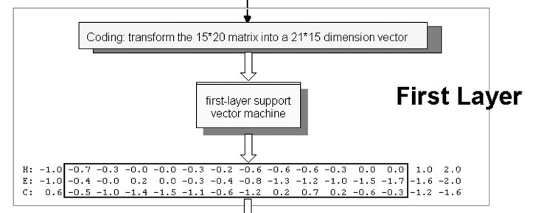
Coding Scheme
N-terminus
⁺H₃N
Amino end
Pro
Gly
Thr
Gly
Amino acid subunits
Thr
Gly
Glu
Seu
Lys
Cys
Pro
Leu
Met
Val
Lys
Val
Leu
Asp
Ala
Arg
Val
Gly
Ser
Pro
Ala
Glu
Lle
Asp
Thr
Lys
Ser
Tyr
Trp
Lys
Ala
Leu
Gly
lle
Ser
Pro
Phe
His
Glu
His
Ala
Glu
Thr
Val
Phe
Ala
Val
Asn
lle
Asp
Thr
Ala
Tyr
Ser
Arg
Ala
Arg
Pro
Gly
Leu
C-terminus
Leu
Ser
One-against-rest strategy strategy was used for the multiclass classification, (H / ~H, E / ~E and C / ~C)
Pro
Tyr
Ser
Tyr
Ser
Thr
Thr
Ala
o
Val
c
Val
Glu
–
Thr
Lys
o
Pro
Asn
Carboxyl end

Slide 12
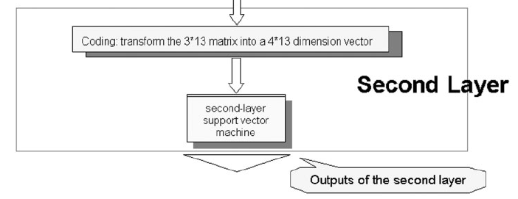
Coding Scheme
Find the largest output value!
One-against-rest strategy strategy was also used for the multiclass classification, (H / ~H, E / ~E and C / ~C)

Slide 13
Training and Testing
The whole data set was randomly divided into 7 subsets of equal size.
Using SVM^{light} program.
Using radial basis function (RBF) kernel in both the first- and the second-layer SVM.
CB513
γ₁ = 0.05, C₁ = 2.0, γ₂ = 2.4, C₂ = 2.5.
CB396
γ₁ = 0.05, C₁ = 2.3, γ₂ = 2.5, C₂ = 2.0.

Slide 14
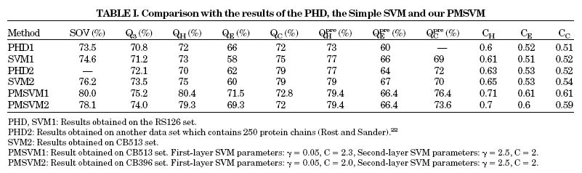
Results

Slide 15
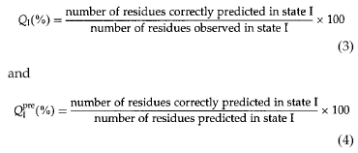
Results
Example:
Observed
Predicted
Observed:
H H H H E E E C C C
H
Predicted:
C H H H E E E C C C
H
E
Q_{H}^{obs} = Q_{H} = 3/4 = 80%
C
Q_{H}^{pre} = 3/3 = 100%
H
E
H
C

Slide 16
Results
The prediction accuracies using only the first-layer SVM have been computed. Although the value of Q₃ was nearly the same as with the dual-layer prediction method, the SOV was about 2% lower. The results reflect the fact that the second layer filters some noise from the first layer and improves the accuracies.

